Slide 1
Important Note Regarding This Microsoft PowerPoint Presentation
* Do not include this slide in your presentation *
This slide deck has been intentionally provided with very limited graphics and formatting to simplify content integration into your own preferred PowerPoint themes and styles.

Slide 2
Security Development Lifecycle (SDL) Field Content
Security Code Review (Level 200)

Slide 3
Agenda
Overview of the Microsoft SDL
Overview of the security code review process
Security code review examples
  Buffer overflow
  SQL injection
  Cross-site scripting
Microsoft SDL security code review recommendations

Slide 4

Microsoft Security Development Lifecycle (SDL)
Training
Requirem-ents
Design
Implemen-tation
Verification
Release
Response
Delivering secure software requires:
Executive commitment → SDL a mandatory policy at Microsoft since 2004
Education
Technology and Process
Accountability
Ongoing Process Improvements → 6 month cycle

Slide 5
Security Code Review Overview
Security Code Review: Manual inspection of application source code to identify security vulnerabilities at the code level
Should be performed when application code is stable / nearly completed
Conducted as part of “Security Push” (Microsoft SDL Verification Phase)
Performed by developers, testers and security analysts

Slide 6
Security Code Review Illustrated
The Microsoft Security Development Lifecycle (SDL) are the industry-leading software security assurance process. A Microsoft-wide initiative and a mandatory policy since 2004, SDL have played a critical role at embedding security and privacy into Microsoft software and culture. Combining a holistic and practical approach, SDL introduced security and privacy early and throughout the development process.
#include <stdio.h>
#include <windows.h>
void function(char * str)
{
if (str != NULL)
{
printf(str);
}
}
int main(int argc,char **argv)
{
char buffer[32];
strcpy(buffer,argv[1]);
function(buffer);
}

Slide 7
The Importance of
Security Code Review
Are manual security code reviews really necessary?
  Microsoft PREFast, Microsoft FxCop and other code analysis tools
Gaps between detectable risk from code analysis tools and actual risk present
Security code review demonstration

Slide 8
Security Code Review
Pros and Cons
Pros
Deeper analysis possible with fewer false-positives and false-negatives
More context-aware analysis
Cons
Manual process
Dependent on skill and expertise of the reviewer
Security code reviews are not meant to replace other assessment activities, and certainly is not to be considered a “silver bullet”

Slide 9
Security Code Review Tips
Multi-pass approach
  Specific vulnerabilities
  Different reviewers
Focus efforts on higher priority code
Establish clear objectives
  Check return values
  Check all pointers
  Validate all un-trusted data

Slide 10
Integrating Security Code Review into Software Development Lifecycles
Update Security Training
Threat Models
Automated
Code Analysis
Security Code Reviews
Update Internal Processes

Slide 11
Security Code Review Examples
Common code level security vulnerabilities:
  Buffer overflows
  SQL injection
  Cross-site scripting
Presentations are available for all of the above vulnerabilities
  You are strongly encouraged to review these presentations if you have not already done so

Slide 12
Example: Buffer Overflow
Code Pattern: Attempting to write data beyond the bounds of a fixed-length buffer
void CopyBuffer(char * src)
{
char Buffer[32];
strncpy(Buffer,sizeof(Buffer),src);
Buffer[sizeof(Buffer)]=‘\0’;
}

Slide 13
Example: SQL Injection
Code Pattern: Attempting to execute dynamically built SQL queries containing un-trusted data
public void RemoveEntry(String EntryName,
SqlConnection myConnection)
{
String Query = @“DELETE FROM Entries WHERE Name=“+EntryName;
SqlCommand myCommand =
new SqlCommand(Query, myConnection);
myCommand.Connection.Open();
myCommand.ExecuteNonQuery();
myConnection.Close();
}

Slide 14
Example: Cross-Site Scripting
Code Pattern: Embedding un-trusted data in Web responses without encoding the data
protected void Page_Load(object sender, EventArgs e)
{
String Name = Request.QueryString["namekey"];
if (!String.IsNullOrEmpty(Name))
{
Response.Write("Hello " + Name);
}
}

Slide 15
Microsoft SDL Security Code
Review Recommendations
Security Push phase of Microsoft SDL and throughout development
Conduct code reviews for high-risk (Priority 1) code
  At risk code and code with a large number of known security vulnerabilities
If time permits, also review Priority 2 code
  Optionally installed components running in user permission levels

Slide 16
Conclusion
Overview of the security code review process
Security code review as a complementary method to other security assessment methods
Security code review advantages and disadvantages
Microsoft SDL security code review recommendations

Slide 17
Appendix

Slide 18


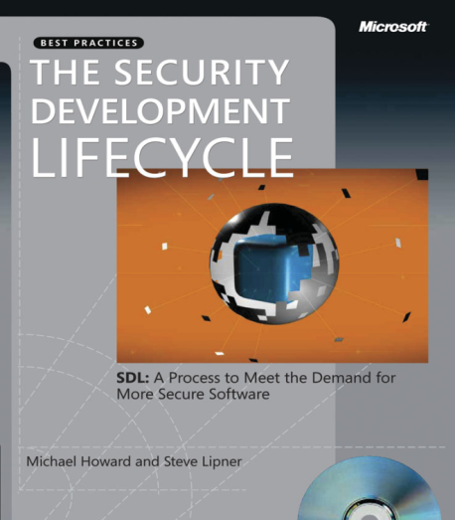


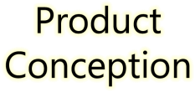
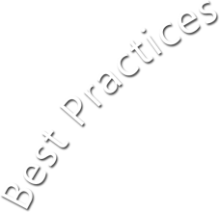






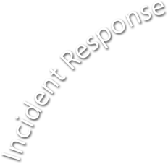















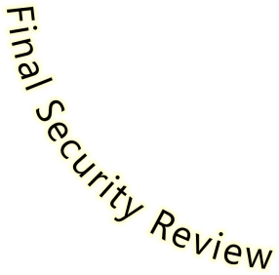








Microsoft Security Development Lifecycle (SDL)
SDL Book:
http://www.microsoft.com/mspress/books/8753.aspx
Official SDL Web Site: http://www.microsoft.com/sdl

Slide 19
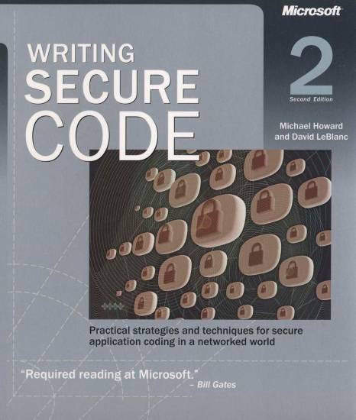
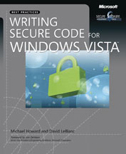
Microsoft Writing Secure Code
Book Series
Writing Secure Code,
2nd Edition:
http://www.microsoft.com/mspress/books/5957.aspx
Writing Secure Code for Windows Vista:
http://www.microsoft.com/mspress/books/10723.aspx

Slide 20
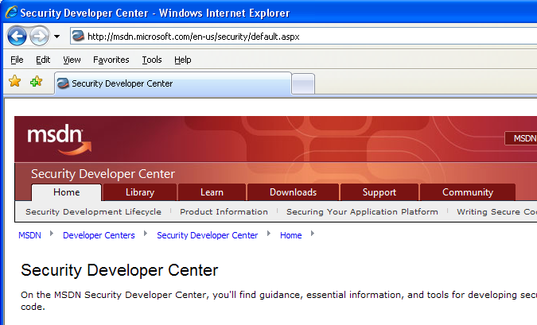

Microsoft Developer Network (MSDN) Security Developer Center
Official Web site: http://msdn.microsoft.com/security

Slide 21
Secure Development Blogs
The Microsoft Security Development Lifecycle (SDL) Blog: http://blogs.msdn.com/sdl
Michael Howard’s Blog: http://blogs.msdn.com/michael_howard

Slide 22

Microsoft Hunting Security Bugs
Hunting Security Bugs:
http://www.microsoft.com/mspress/books/8485.aspx

Slide 23
Additional SDL Training Content
Secure Design Principles
Secure Implementation Principles
Secure Verification Principles
SQL Injection Vulnerabilities
Cross-Site Scripting Vulnerabilities
Buffer Overflow Vulnerabilities

